Slide 1
Early Career and Engagement IG

Slide 2
Agenda
Introduction to ECEIG
Lightning Talks
3’ minutes per person, maximum 1 slides (strictly enforced)
Brief, elevator-pitch description of own research
Relevance to RDA
What are your expectations for ECEIG
Discussion within ECEIG
Point A: Describe our goals for ECEIG: GitHub, Slack, Mentoring
Point B: Mentoring program.
Short self intro of mentors in the room
Wrap-up - Next steps

Slide 3
Purpose of ECE IG
Early career researchers and professionals usually need additional support for:
networking amongst themselves to learn about other Early Career scientists and their research, i.e., establishing a “network of peers”, and
mentoring from senior RDA members who are interested in mentoring Early Career Researchers and Professionals.
Notes:
The basic premise of the Early Career and Engagement Interest Group, which we refer to as the ECEIG, is that early career researchers and professionals need additional support for networking amongst themselves to learn about other people and their research. We also have used this Interest Group to develop mechanisms for early career mentoring.

Slide 4
Objectives of ECE IG
Focus on Early Career Researchers and Professionals because they need the most support
Establish a volunteer-based mentoring progamme
Network across domains to establish an interdisciplinary network of peers
Provide a space for people who have more experience with RDA to pass on knowledge and lessons learned to Early Career Researchers and Professionals
Create a social outlet specifically for Early Career Researchers and Professionals
Notes:
The ECEIG has five primary objectives. First, we aim to focus on early career researchers and professionals because we believe they need the most support. Second, we aim to develop a volunteer-based mentoring program for early career researchers and professionals who desire it. Third, we want to help early career researchers and professionals to network across domains helping them to establish an interdisciplinary network of peers. Fourth, we want to provide a space for people who have experience with RDA to pass on knowledge and lessons learned to early career researchers and professionals. And fifth, we want to create a social outlet specifically for early career researchers and professionals. Since obtaining endorsement from the RDA Technical Advisory Board, we have been focusing specifically on objectives 2, 4, and 5.

Slide 5
Objective #2
Informal mentoring program:
Zoom “Ask Me Anything” sessions where mentees ask questions and mentors answer the questions or put mentees in touch with those who they think can answer their questions.
We hope to encourage more engagement from mentees!
Notes:
To help facilitate objective 2, involving establishing a volunteer-based mentoring program, we have run a series of “Ask Me Anything” Zoom sessions where members of this group have the opportunity to connect with more senior RDA members who are willing to answer mentees’ questions or put the mentees in touch with people who they think can answer their questions. We encourage all members of this group to join these sessions. Don’t be shy! You can literally ask anything! We see this as an opportunity to bridge the gap between early career researchers and people who have more experience and expertise in their careers and with RDA. We also see these as an opportunity to help BRIDGE THE GAP BETWEEN PLENARIES. Even if you can’t attend the plenaries, you can attend these virtual sessions to receive mentoring and support because once an RDA member, always an RDA member!

Slide 6
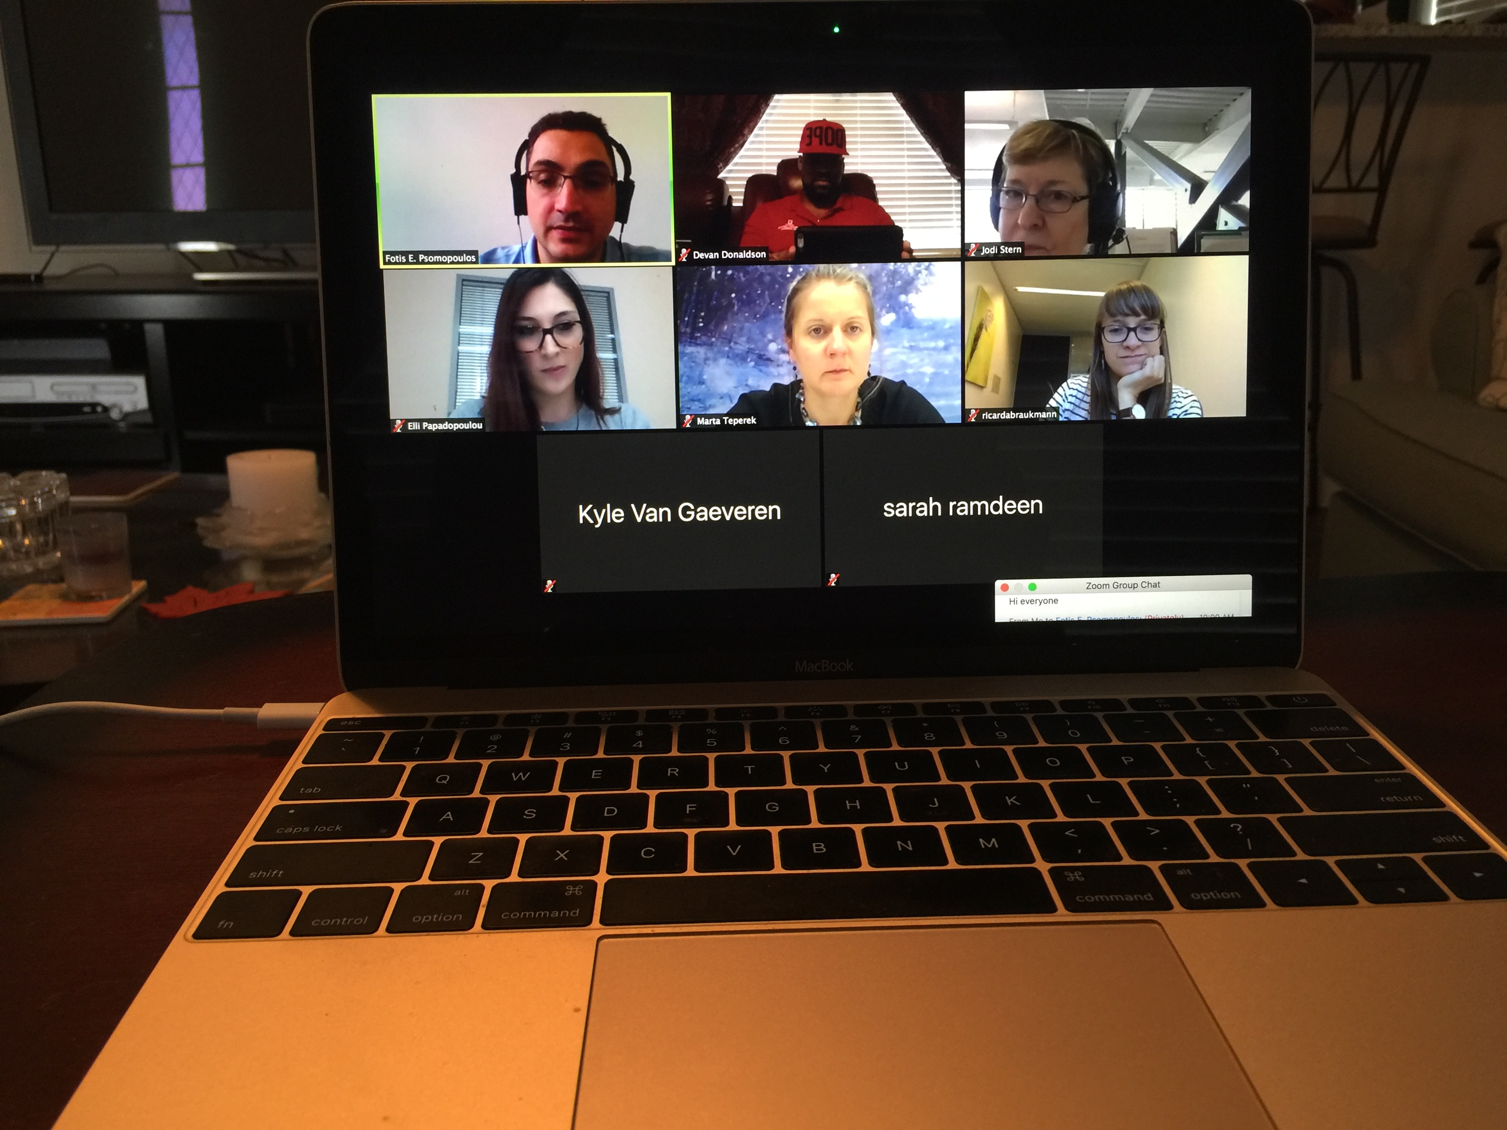
Objective #2
Notes:
Here’s a screenshot from one of our zoom sessions. The sole purpose of these videoconferences is for early career researchers to ask questions about their research, professional development, or any questions they may have about how to link their research interests to their involvement in RDA. We hold these video conferences THE THIRD WEDNESDAY OF EVERY MONTH. Each time, we have a variety of mentors on call who take time out of their busy schedules to answer your questions or put you in touch with people they know that they think can help you with your questions.

Slide 7
Objective #2
Mentor Name | Affiliation(s) Institution(s) | RDA WG/IG Affiliation(s) | Expertise (Keywords)
Jay Pearlman | IEEE | Brokering Framework WG, etc.
Jörg Geiger | University of Wuerzburg | RDA/NISO Privacy Implications of Research Data Sets IG (co-chair), Health Data IG, | Biobank, Standardization, Terminology, Metrology, Privacy, Ethics
Lynn Yarmey | Research Data Alliance | Director of RDA/US Community Development, RDA Secretariat, new group process manager | data curation, landscape overview and analysis, community development
Mark Parsons | RPI | ESIP/RDA Earth, Space, and Environmental Sciences IG, PID IG, Data Citation WG | Data curation and stewardship, data citation, PIDs, community building
Marta Teperek | TU Delft | Libraries for Research Data IG | data stewardship, open science, data privacy, repositories, FAIR Data
Peter McQuilton | Oxford e-Research Centre | BioSharing Registry: connecting data policies, standards & databases in life sciences WG | Standards, data curation, data management, databases, data policies, open science, data stewardship, life sciences, biomedical sciences
Raman Ganguly | University of Vienna | Long tail of research data IG
Ruth Duerr |  | Preservation e-Infrastructure IG, Preservation Tools, Techniques, and Practices IG
Sarah Jones | Digital Curation Centre | Active Data Management Plans IG, CODATA/RDA Data Science Schools WG | DMPs, research data management, open science, archives, data sharing, FAIR data,
Shaun de Witt | UKAEA | n/a
Sünje Dallmeier-Tiessen | CERN | RDA PID | reproducible research, PID, repositories, data curation
Notes:
Here’s the list of current mentors. As you can see from this list, our mentors have a broad range of expertise and experience, and they are heavily involved in RDA. They also know a lot of people from a lot of different disciplines, so they can definitely guide you to the right person if they cannot answer your question directly!

Slide 8
Objective #2
Our ECEIG Mentoring Videoconferences are scheduled for the THIRD WEDNESDAY OF EVERY MONTH! PLEASE ATTEND :0)
Our next mentoring session is Wednesday, November 21, 2018 at 10AM EST at https://iu.zoom.us/j/6703697984
Notes:
Again, this is free help for you! Free mentoring and support just for you! We are doing these every month and our next session is on Wednesday, November 21st at 10AM Eastern Standard Time. If you join the ECEIG Listserv which is up on our page from the RDA website, we always send emails out to that listserv about these events, so be sure to do that to be kept up to date about our events.

Slide 9
Objective #4
We have setup the following channels of communication:
a GitHub repository for maintaining documents with advice/lessons/guidelines as well as receiving continuous feedback and edits in the form of issues https://github.com/fpsom/rda-eceig
a dedicated Slack group for live communication within the community, with specialized channels for specific issues (such as Plenary events, or domain-specific questions) https://rda-eceig.slack.com/
Notes:
To further facilitate objective 4, which involves providing a space for people who have experience with RDA to pass on knowledge and lessons learned to early career researchers and professionals, we have set up two communication channels. These efforts are designed to address the whole “How do we stay connected between plenaries?” issue. The first communication channel we’ve created is a GitHub repository for maintaining documents with advice, lessons learned, and guidelines. We have also created the GitHub repository as a means for receiving continuous feedback in the form of issues. The second communication channel is a dedicated Slack group for live communication within the community, which specialized channels for specific issues, such as plenary events or domain-specific questions.

Slide 10
Objective #5
Create a social outlet specifically for Early Career Researchers and Professionals
By organizing local social outings at each of the RDA plenaries
Our first RDA ECEIG event was in Montreal
Notes:
To address our fifth objective, we have organized local social events at each RDA plenary.

Slide 11
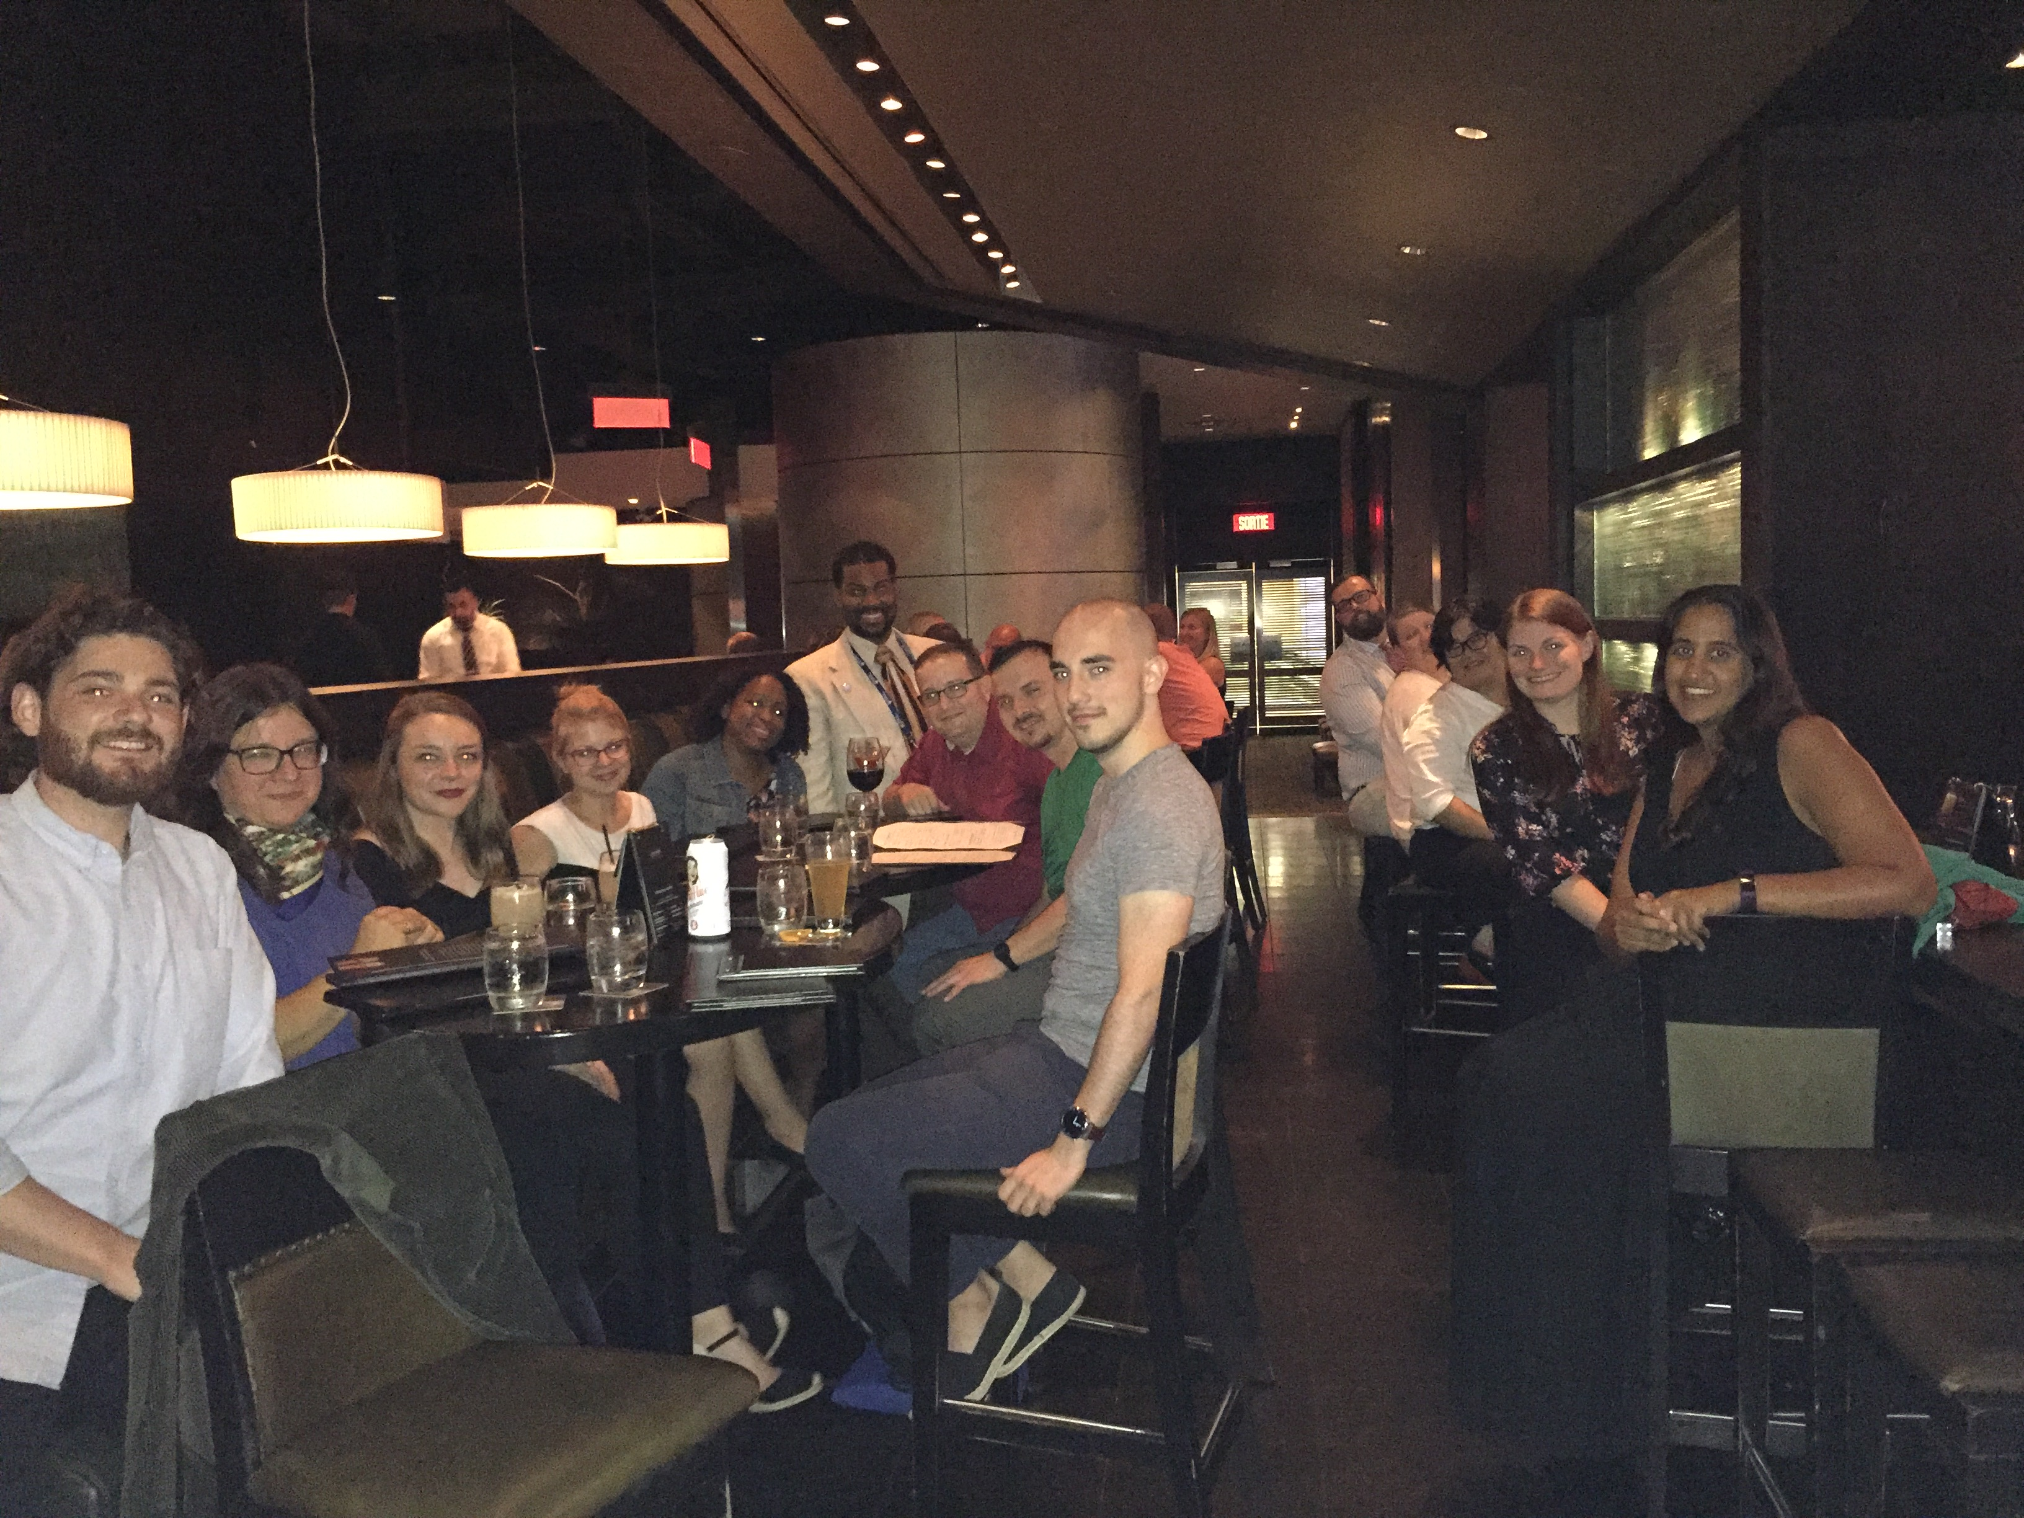
First RDA ECEIG Social Event
Notes:
Our first social event was at a local restaurant near the plenary conference venue. We believe that the social component is just as important as the other components of the IG because you need to get to know each other as a critical first step in later being able to work with each other! We did not schedule a social event this time because this year the WDS Early Career Researchers network hosted a social event, and we were invited to attend it. We hope to work with their organization in the future and to co-host events that will bring together early career researchers from all of these different programs.

Slide 12
Lightning Talks
3’ minutes per person
Brief, elevator-pitch description of own research
Relevance to RDA
What are your expectations for ECEIG

Slide 13


ECR Network and RDA ECEIG
Early Career Researchers and Scientists Network
2017-2020 Co-Chairs:
Alice Frémand, EOST, Université de Strasbourg
Sabrina Delgado Arias, Science Systems and Applications, Inc./NASA GSFC
Ivan Pyshnograiev, Igor Sikorsky Kyiv Polytechnic Institut
Crédits : Creative Commons / luckey_sun

Slide 14
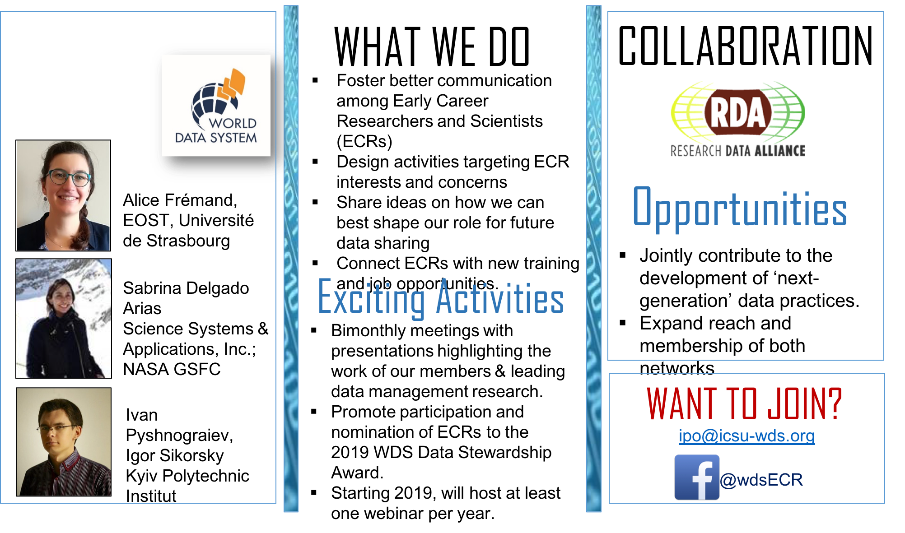

Slide 15
Goals of ECEIG
The ECEIG will focus on:
How to better engage early career scientists and professionals from diverse communities with little experience in the values and solutions offered by RDA.
How to connect the continuously evolving scientific domains and communities with existing RDA IGs/WGs.
How to develop and document the best practices in communicating the values of RDA to each of the involved communities.
How to support the RDA Early Career Fellowship programme, both in terms of documentation and guidance, as well as through potential membership of Fellows in this group.
Notes:
The ECEIG will focus on:
How to better engage early career scientists and professionals from diverse communities with little experience in the values and solutions offered by RDA.
How to connect the continuously evolving scientific domains and communities with existing RDA IGs/WGs.
How to develop and document the best practices in communicating the values of RDA to each of the involved communities.
How to support the RDA Early Career Fellowship programme, both in terms of documentation and guidance, as well as through potential membership of Fellows in this group.

Slide 16
ECEIG Mentoring programme (1/2)
Guidelines for mentors
Attend ECEIG sessions at RDA Plenaries to provide feedback and comments to early career professionals and other participants.
Join discussions through the dedicated Slack group.
Respond promptly to questions from early career people on slack, that are i. relevant to your expertise and/or ii. relevant to RDA operations in general.
Be open to having meetings (virtual or otherwise) with ECEIG members following up on discussions through Slack, if you are able.
Notes:
Guidelines for mentors
Attend ECEIG sessions at RDA Plenaries to provide feedback and comments to early career professionals and other participants.
Join discussions through the dedicated Slack group.
Respond promptly to questions from early career people on slack, that are i. relevant to your expertise and/or ii. relevant to RDA operations in general.
Be open to having meetings (virtual or otherwise) with ECEIG members following up on discussions through Slack, if you are able.

Slide 17
ECEIG Mentoring programme (2/2)
Guidelines for mentees
Attend ECEIG sessions at RDA Plenaries and participate in session activities.
Join discussions through the dedicated Slack group - ask questions to either the general channel or to topic-specific channels.
When asking a question try to be as specific as possible so that the right person can address it.
Promote your work and your interests.
Be an active member of the ECEIG.
Notes:
Guidelines for mentees
Attend ECEIG sessions at RDA Plenaries and participate in session activities.
Join discussions through the dedicated Slack group - ask questions to either the general channel or to topic-specific channels.
When asking a question try to be as specific as possible so that the right person can address it.
Promote your work and your interests.
Be an active member of the ECEIG.

Slide 18
Meeting with ECEIG
Meet the Mentors (introduce yourselves to group)
Notes:
Now let’s have the mentors, if there are any in the room, introduce themselves, where they are from, what research they do, and their involvement in RDA.

Slide 19
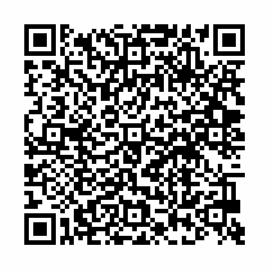
How to Join the Discussion
Join ECEIG
https://www.rd-alliance.org/groups/early-career-and-engagement-ig
Join the Slack group – the invitation link is this →
Monitor the documents and information in the GitHub repository.
https://github.com/fpsom/rda-eceig
Notes:
As I mentioned earlier, there are multiple ways that you can join in and be engaged with the ECEIG. First, by joining this group on the RDA website and signing up for the group listserv.

Slide 20
How to Join the Discussion
Follow ECEIG on Twitter
@rdaeceig
Notes:
Also, be sure to follow us on Twitter

Slide 21
Future Steps
Structures and ideas are all in place, so we need:
Engagement from everyone!

Slide 22
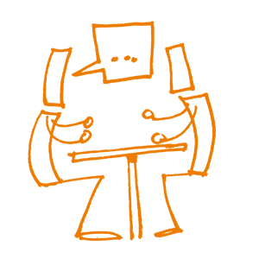
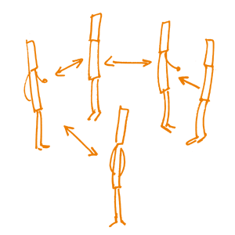
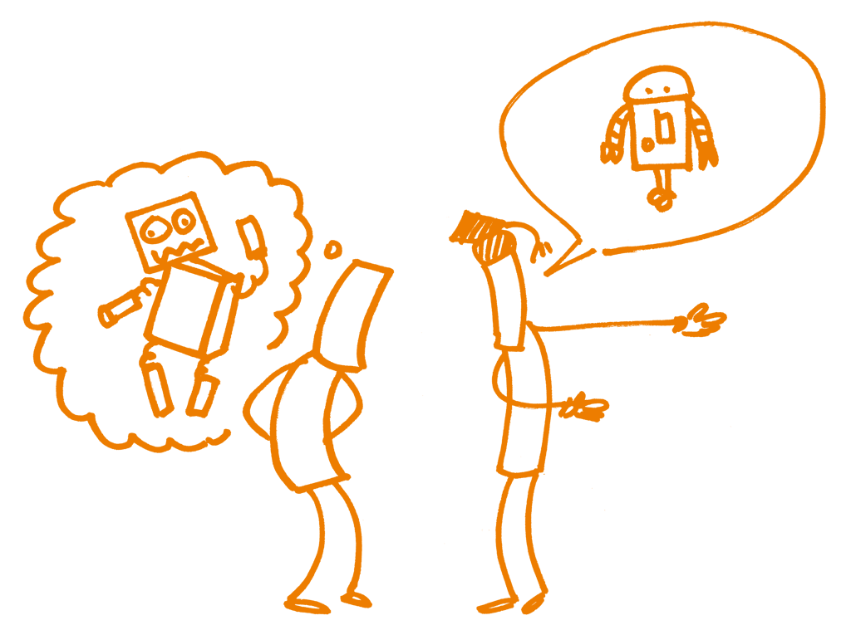
Thanks!

